Slide 1
MIREOT Minimum information to reference external ontology terms
Jie Zheng and Yongqun (Oliver) He
2011 ICBO OBI Tutorial

Slide 2
What is MIREOT?
MIREOT stands for Minimum Information to Reference External Ontology Terms
A mechanism to specify, in your ontology, individual terms you want to use from another ontology

Slide 3
Why MIREOT?
Import of a whole ontology may have too much overhead or may cause inconsistencies and unexpected inferences.
Creating new terms that replicate those in other ontologies is redundant and makes data integration harder, even if you cross-reference back to the original resource.
If we specify terms of interest, tools can use that information to manage importing needed information to our ontology

Slide 4
What is the minimal information required to refer to another ontology’s term?
IRI of the class
IRI of the source ontology
Superclass of the class in your ontology
this minimal set allows unambiguous identification of a term. Based on this, additional information related to the term can be accessed by tools.

Slide 5
Desirable additional information
Annotations, such as:
Label
Definition
Synonym
Axioms (but this may be tricky)

Slide 6
MIREOTing automatically
Perl + Lisp(java) scripts
Used for OBI development
Needs to be customized for each ontology
OntoFox
Web-based tool aimed to be easily used by all developers

Slide 7
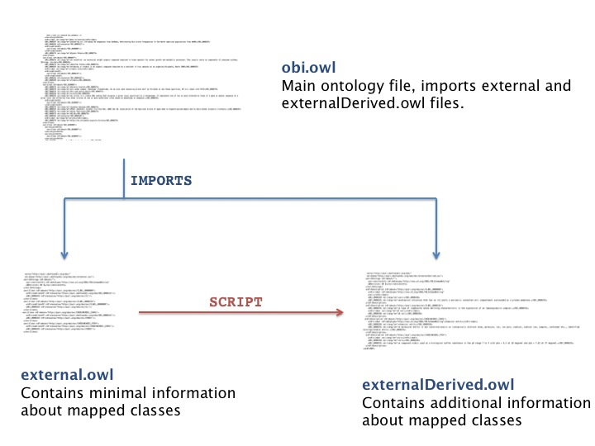
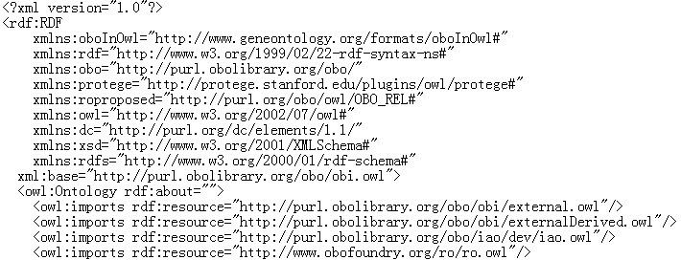
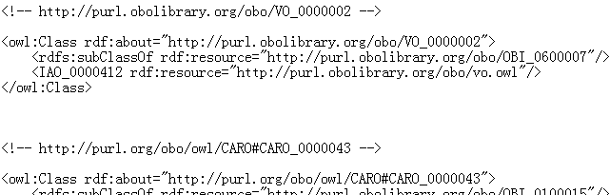
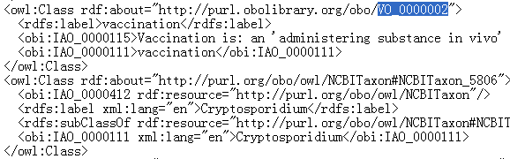
Scripts used by OBI
3
URI of external term
Position in the
target ontology
URI of the source ontology
1
2
Perl script
Lisp script

Slide 8
Useful Links
Scripts are available under our SVN repository:
http://purl.obolibrary.org/obo/obi/repository/trunk/src/tools/
add-to-external.pl
http://purl.obolibrary.org/obo/obi/repository/trunk/src/tools/build
create-external-derived.lisp
external-templates.txt
Detailed tutorial of the scripts:
http://obi-ontology.org/page/Tutorials#MIREOT
Mélanie Courtot, Frank Gibson, Allyson L. Lister, James Malone, Daniel Schober, Ryan R. Brinkman, and Alan Ruttenberg, MIREOT: The minimum information to reference an external ontology term. Applied Ontology, Vol. 6, Nr. 1 (2011) , p. 23-33

Slide 9
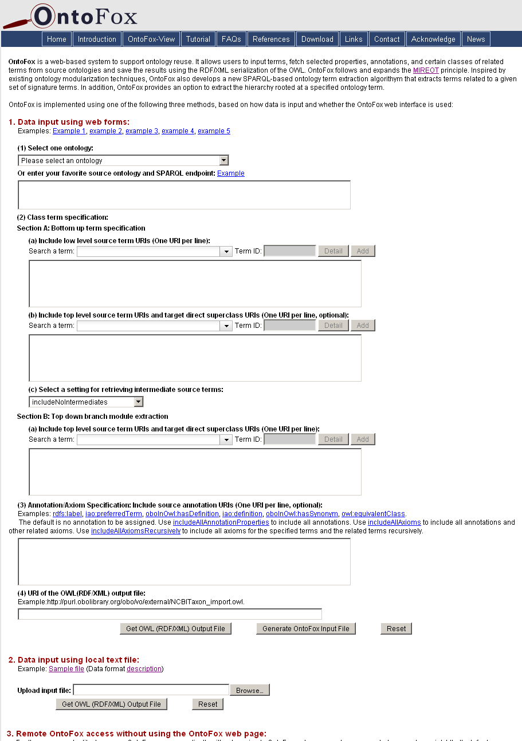
OntoFox: A web application for MIREOTing
Adds MIREOT specifications and imports a variety of term-related information
Web-based data input and output
Output OWL file can be directly imported in your ontology
No programming needed for users
http://ontofox.hegroup.org

Slide 10
Take home message
MIREOT mechanism allows reusing external ontologies
Multiple implementations are being developed

Slide 11
Acknowledgements
Mélanie Courtot
Alan Ruttenberg
Zuoshuang(Allen) Xiang
The OBI Consortium

Slide 12
Community View of OBI
Jie Zheng and Yongqun (Oliver) He

Slide 13
OBI
Over 20 different communities involved in OBI development
Each community frequently uses a subset of OBI terms
Each community may have its own community preferred labels

Slide 14
Community View
Annotation property approach
Tag the terms for which a specific community is interested
Provide community-preferred labels
Example usage of annotation property ‘alternative term’
FGED alternative term
IEDB alternative term

Slide 15
View Implementation
Tag terms using community-specific annotation property
Option 1: Add annotation property in the terms in obi.owl directly
Option 2: Mark the terms in a spread sheet
Extract the tagged subset of obi.owl including related terms and axioms based on annotation property specifying community
OntoFox-View: OntoFox-based community view generator (under development)

Slide 16
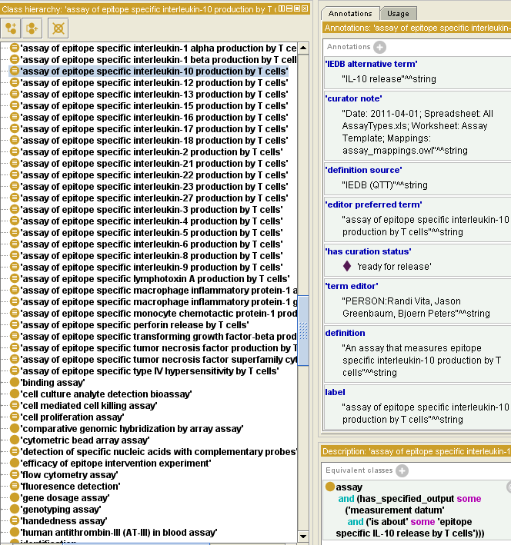
OntoFox-View: Option 1
load
RDF store
(obi.owl)
SPARQL
queries
OntoFox-View
OWL(RDF/XML)
output file
http://ontofox.hegroup.org/ontofoxview/index2.php
IEDB alternative term
Extract terms with ‘IEDB
alternative term’ property and
the axioms related to them
obi.owl

Slide 17
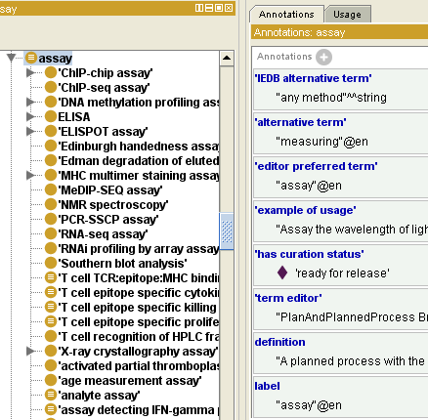
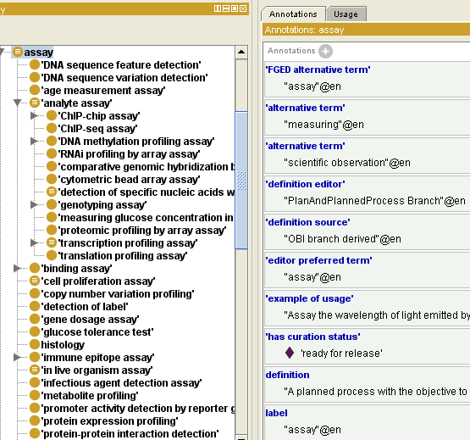
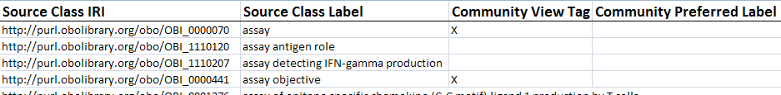
OntoFox-View: Option 2
load
RDF store
(obi.owl)
SPARQL
quires
OntoFox-View
OWL(RDF/XML)
output file
FGED alternative term
1. Extract terms with ‘FGED
alternative term’ property and
axioms related to them
2. Add FGED alternative term
property to FGED terms
http://ontofox.hegroup.org/ontofoxview/index2.php

Slide 18
Take home message
OBI can be tailored to different community needs
Different implementations are being developed
Keep information in obi.owl
Keep information in external spreadsheet

Slide 19
Acknowledgements
Chris Stoeckert
Mélanie Courtot
Bjoern Peters
Alan Ruttenberg
Zuoshuang(Allen) Xiang
The OBI Consortium

